Slide 1

E-commerce
Analysis
from Multi-category store
Project 4 – Group 3
Ali Yazdan
Ashrita Surisetti
Malini Sintre

Slide 2

Project Overview
In the rapidly evolving landscape of e-commerce, understanding customer behavior and efficiently categorizing products are pivotal for enhancing user experience and optimizing inventory management.
Our project aims to address these challenges through a comprehensive analysis and a robust machine learning model.
Analyse e-Commerce Customer Behaviour
Product and Brand Analysis
Sales Analysis by Product
Product Category Classification
Predict the Customer Engagement

Slide 3

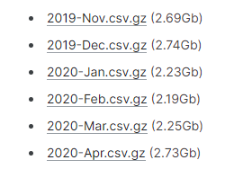
Data Source
Kaggle
https://www.kaggle.com/datasets/mkechinov/ecommerce-behavior-data-from-multi-category-store/data

Slide 4

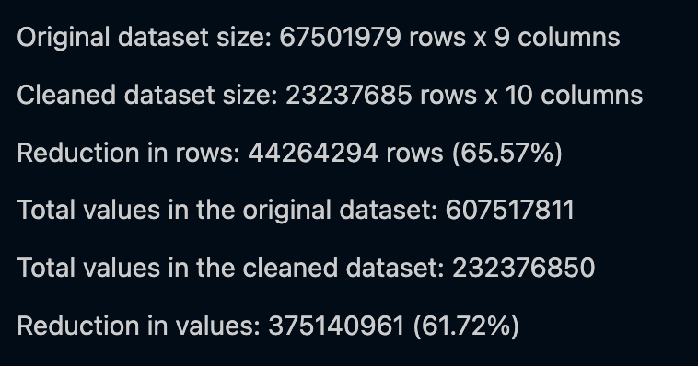
Data Clean-up and Transformation
1. Initial Data Check:
2. Data Cleaning
3. Feature Engineering
4. Filtering and Mapping
5. Category and Product Mapping
6. Final Feature Engineering
7. Saving Cleaned Data

Slide 5
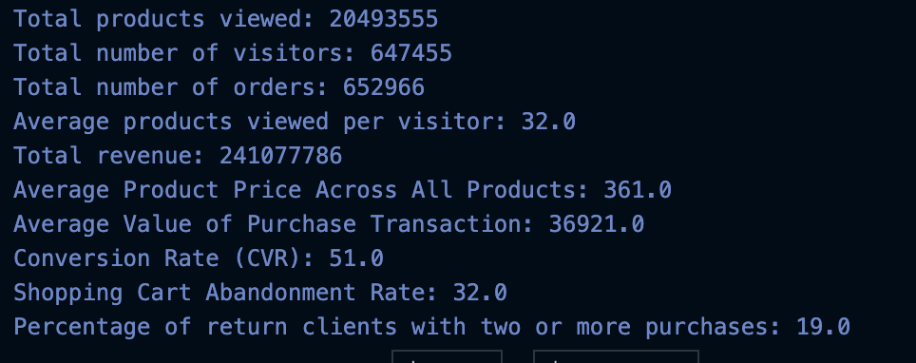
Data Clean-up and Transformation – Post Analysis
1. Key Performance Indicators (KPIs)
2. Top Products and Categories:
Top 5 highest-grossing products.
Top 5 products by conversion rates.
Top 5 product categories by total revenue.
3. Viewing and Purchasing Patterns:
Analysis by hour of the day, day of the week, and day of the month.
Identified peak times for user activity.

Slide 6
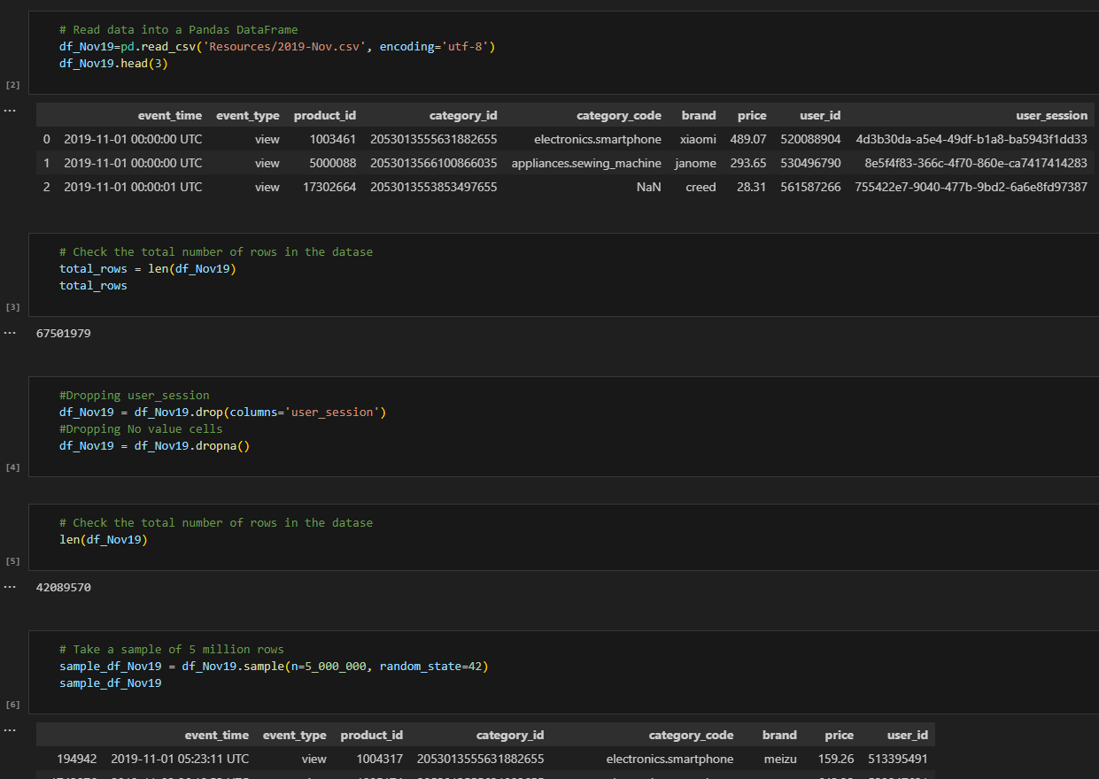
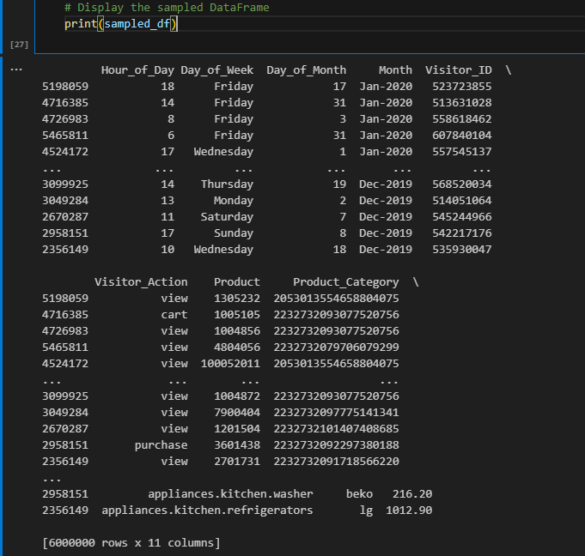
Clean-up of Dataset for Tableau (6 million data)

Slide 7

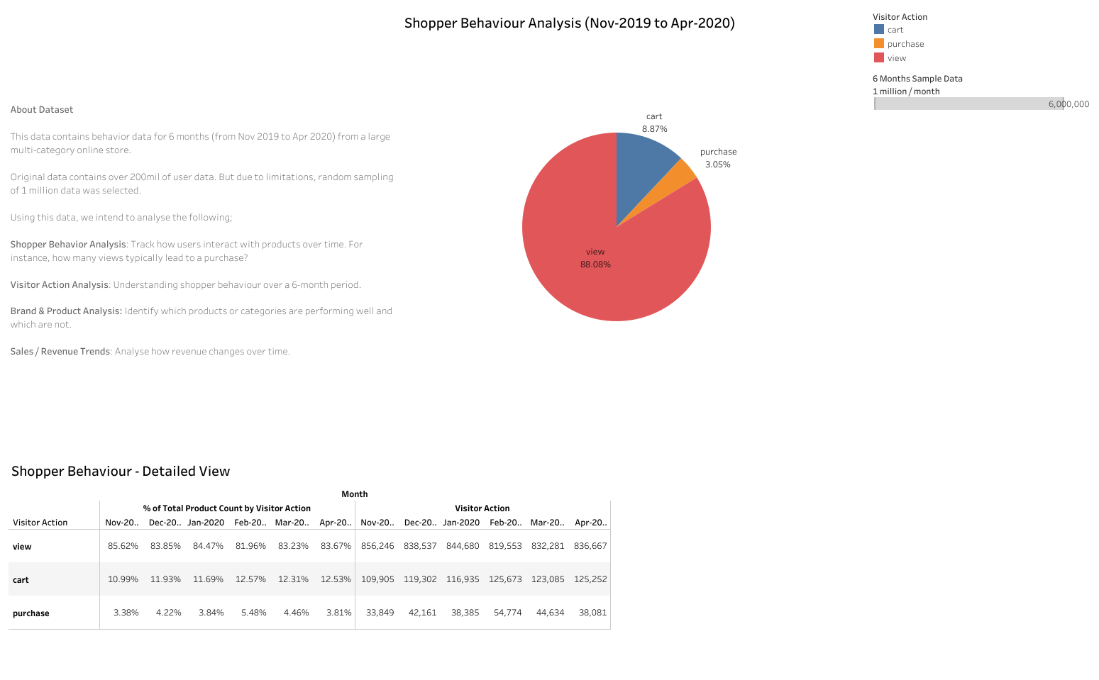
Shopper Behaviour

Slide 8
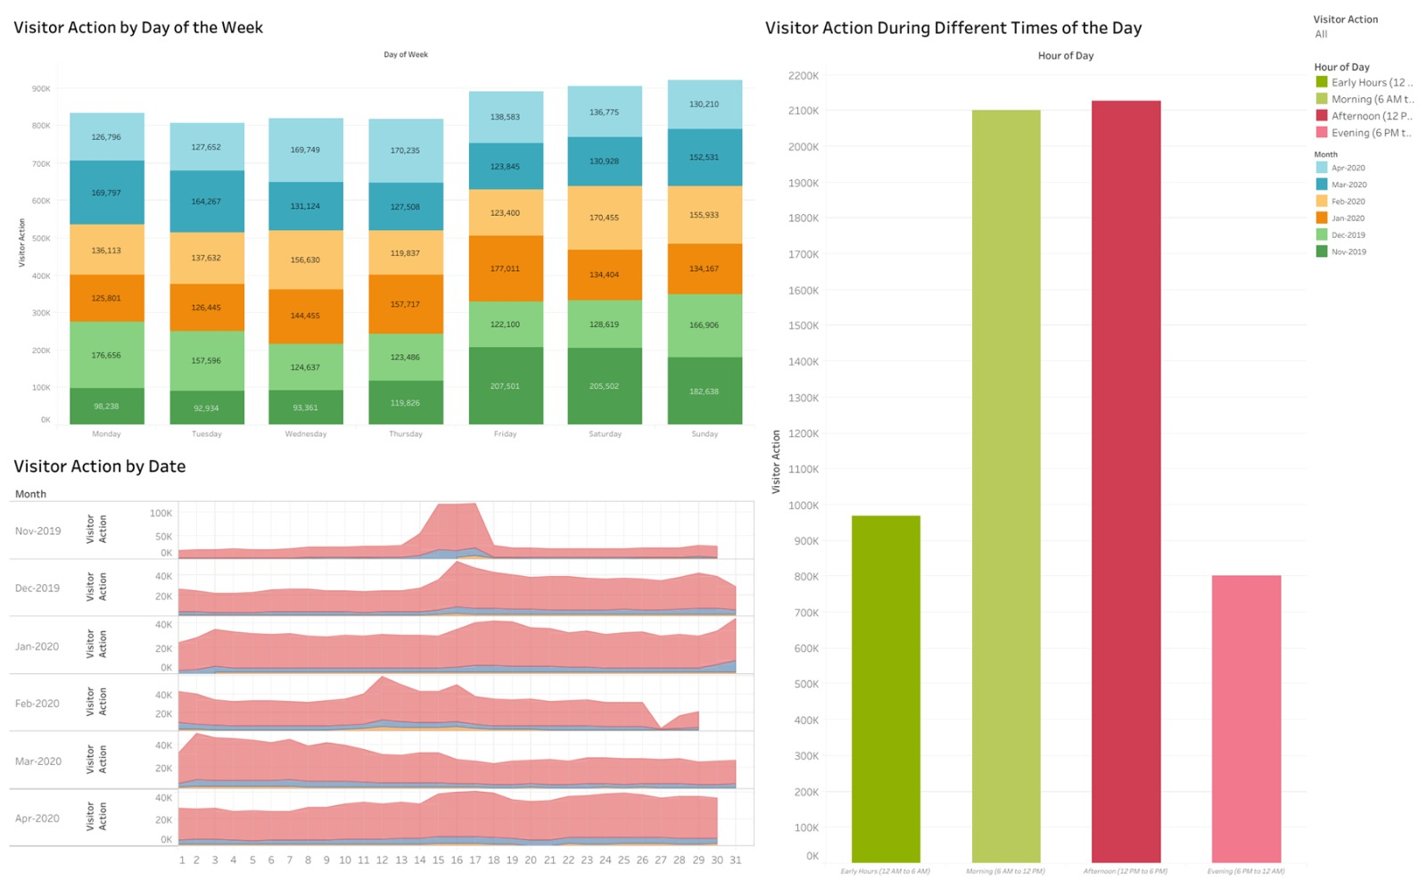
Time Analysis

Slide 9
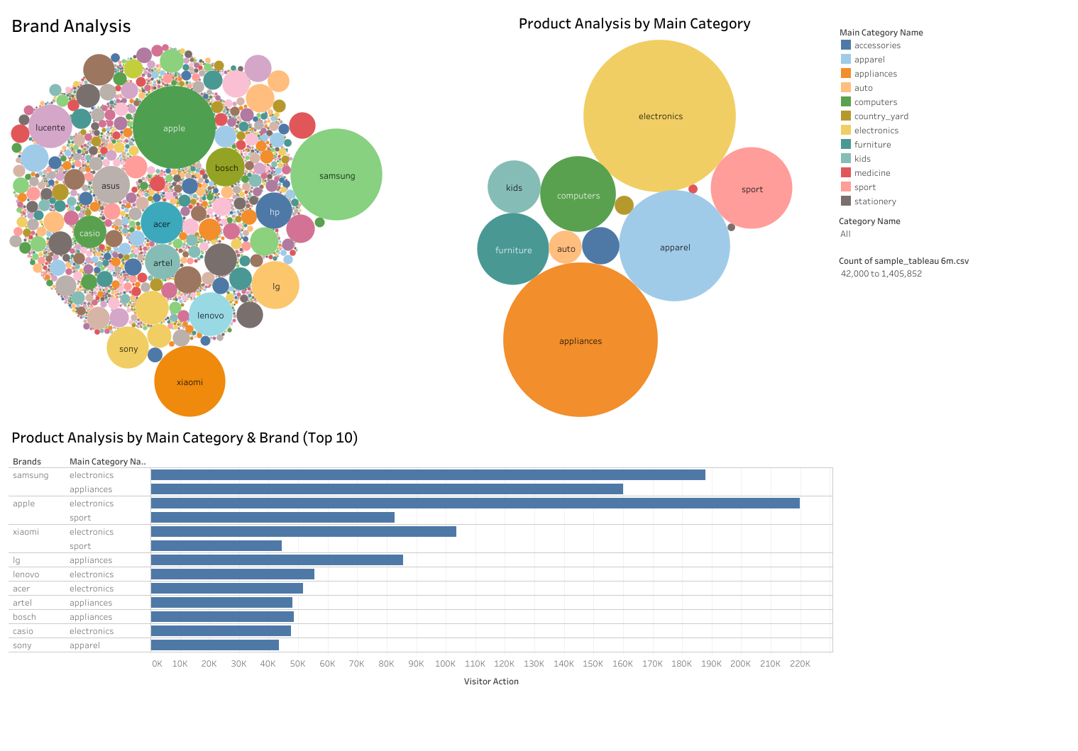
Brand & Category Analysis

Slide 10
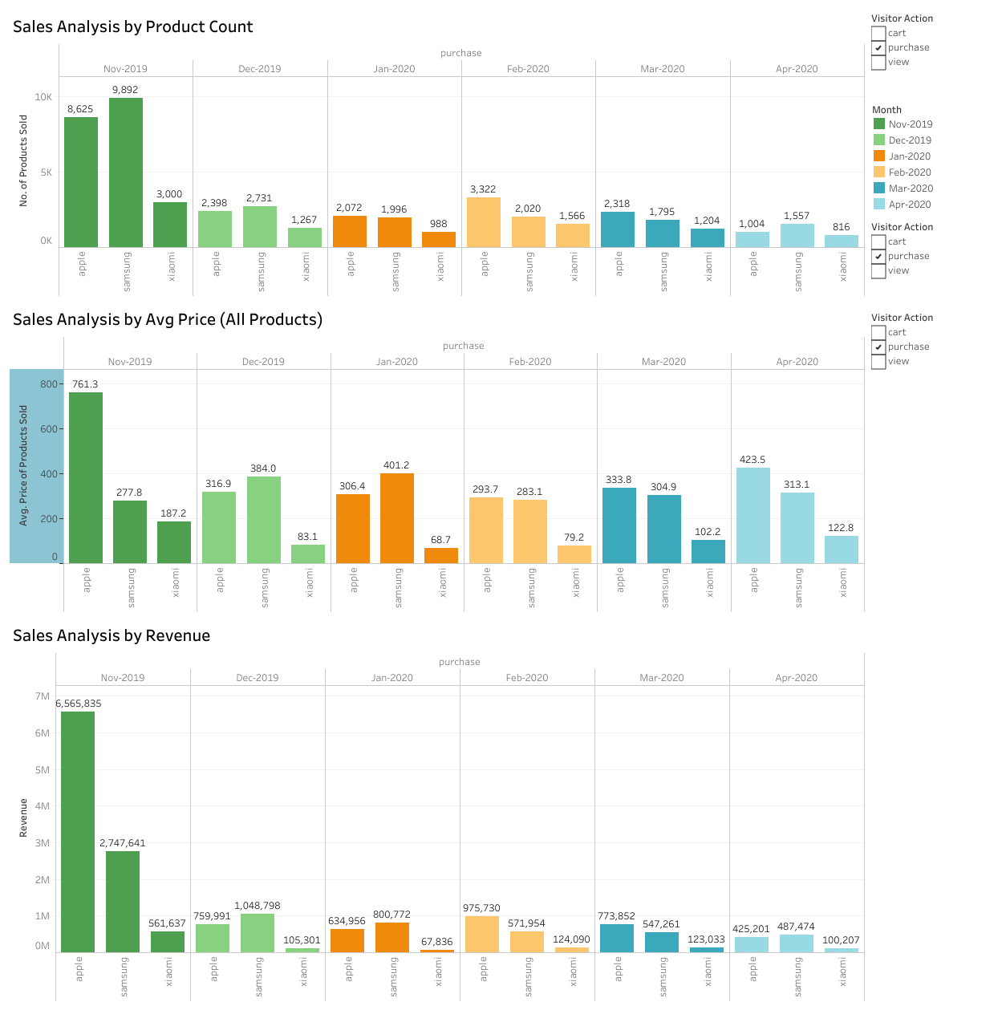
Sales Analysis

Slide 11

Machine Learning
Product Category Classification

Slide 12
Objective
To classify the products into categories
Data
Initially trained the model using 1 GB of data but did not achieve the expected accuracy.
To improve runtime and data efficiency, aggregated columns and merged categories with the least counts.
Final dataset size reduced to 300 MB, consisting of 1.9 million rows.

Slide 13
Data Preprocessing for Machine Learning
Resampled 10% of the data with 190,000 records and considered 42 unique Product Categories.
.
Balanced the dominant class to avoid bias.

Slide 14
Feature Engineering for Machine Learning
Used “feature_importances_” and removed unnecessary columns
.
Encoded Categorical variables using “LabelEncoder”
Scaled numerical variables using “StandardScaler”

Slide 15
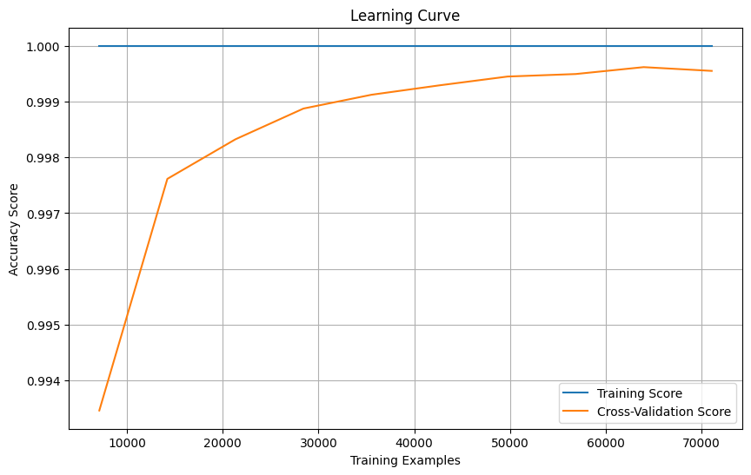
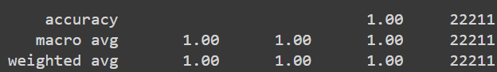
Model Training and Optimisation
Initial Training
Split the data into train and test sets using “train_test_split” function.
Used RandomForestClassifier model and trained it.
Identified overfitting using learning curve.
.

Slide 16
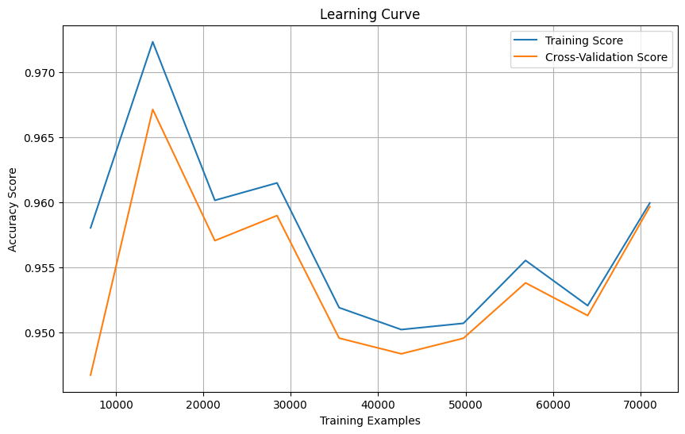
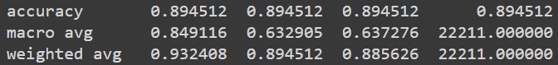
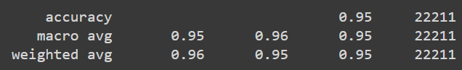
Hyperparameter Tuning
Manually adjusted hyperparameters like max_depth, min_samples_split to reduce overfitting and accuracy is 89% with low recall and f1-scores.
Employed GridSearchCV for automatic hyperparameter optimisation and the final accuracy is 95% with improved recall and f1-scores.
.

Slide 17
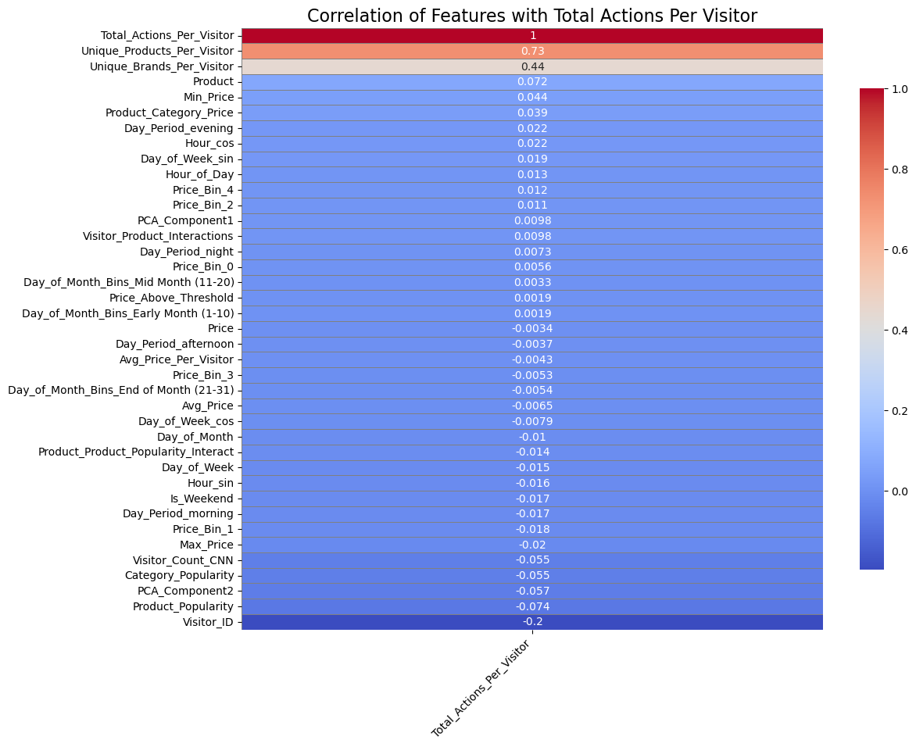
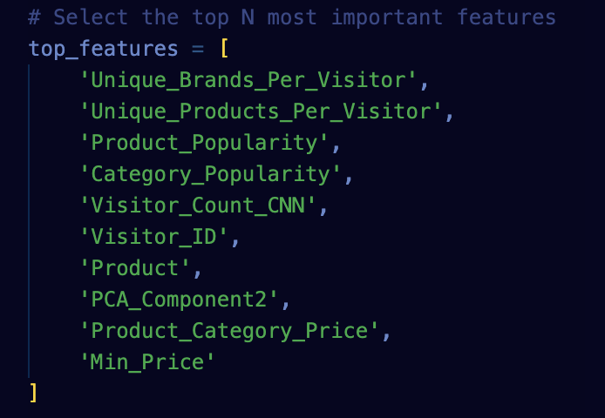
Data Preprocessing for Machine Learning – Part 2
Data Preparation:
Creating SQLAlchemy Engine and Loading Data
Data Type Optimization Category and Price Binning
Handling Missing Values and Duplicates
Stratified Sampling
Principal Component Analysis (PCA)
Correlation Analysis
Feature Engineering
.

Slide 18
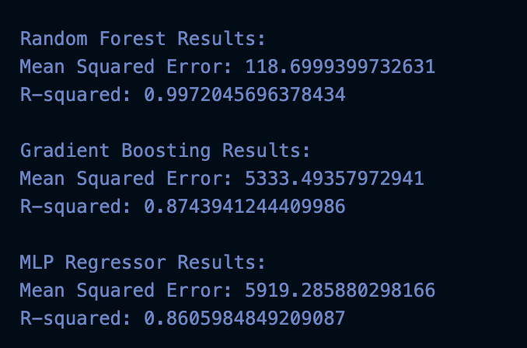
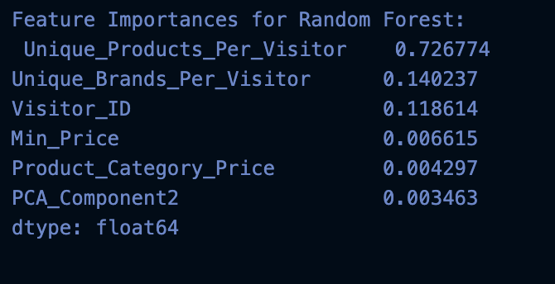
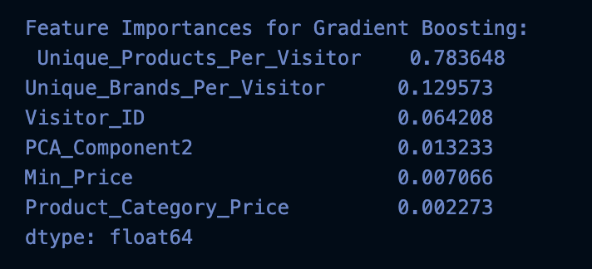
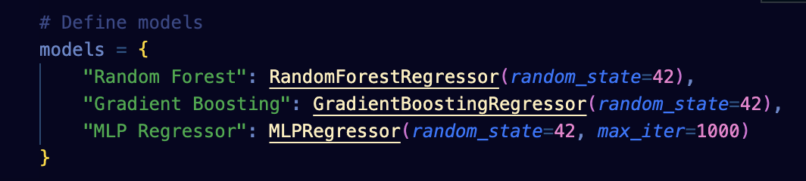
Data Preprocessing for Machine Learning – Part 2
Data Processing and Model Evaluation:
Data Preparation for Machine Learning
Model Training and Evaluation
Feature Importance Analysis
Grid Search for Hyperparameter Tuning
Final Model Training and Evaluation using larger sample
.

Slide 19
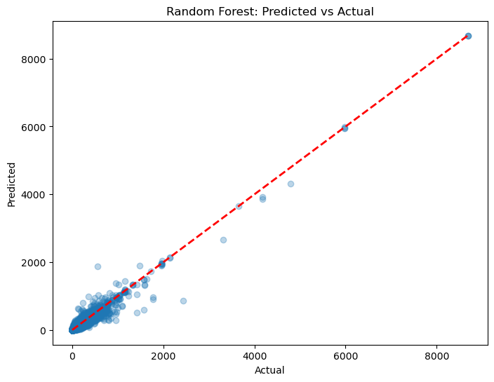
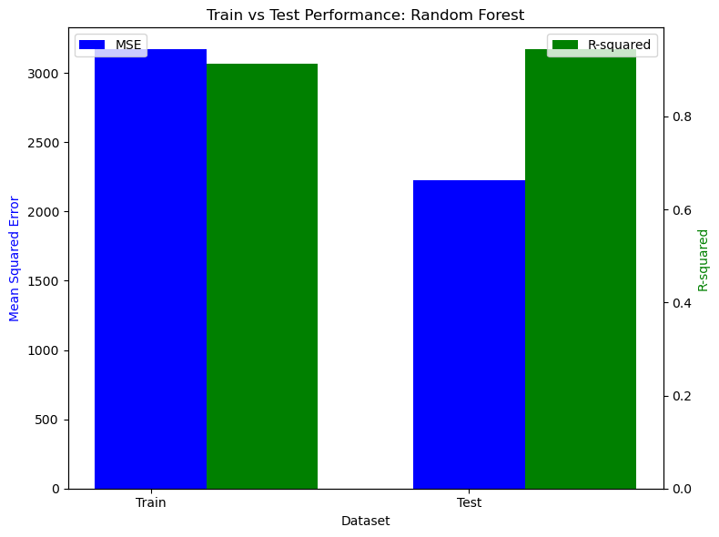
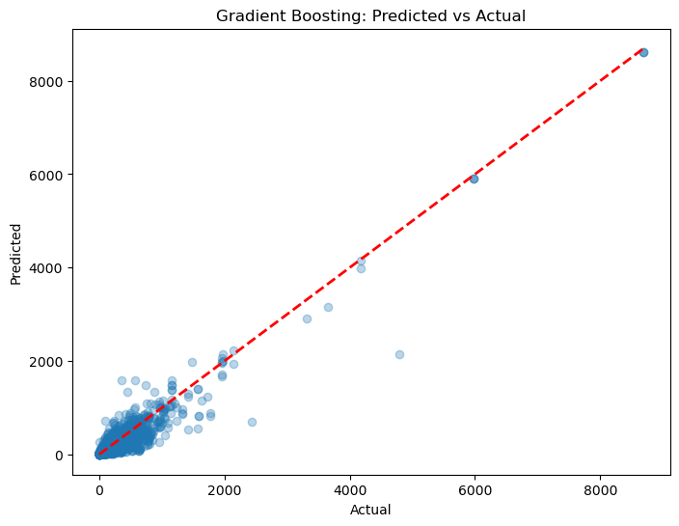
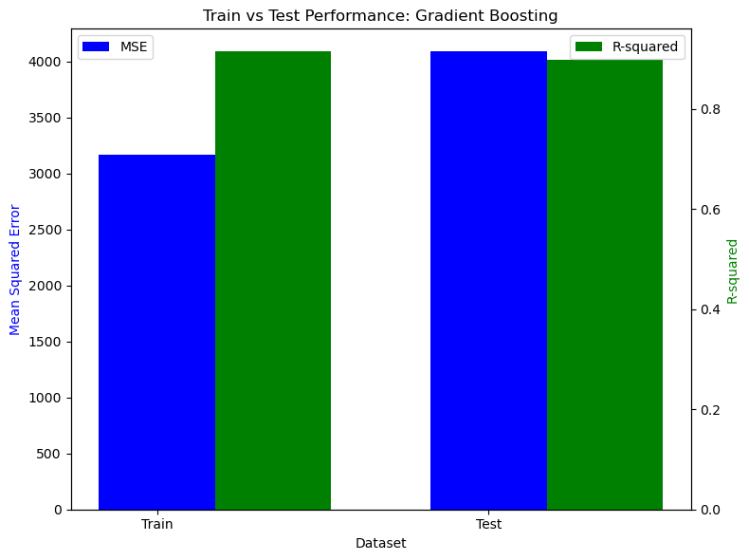
Model Comparisons and Efficiency
.
-Random Forest:
MSE: 65.31
R²: 0.998
-Gradient Boosting:
MSE: 2191.48
R²: 0.948

Slide 20
Conclusion
Most Efficient Model:
The very low MSE and high R² indicate that the Random Forest model fits the data extremely well, making very accurate predictions.
Limitations:
Data compression may lead to information loss.
Data coverage is for the period Nov 2019 - April 2020; trends may vary over time.
Usability:
-Visitor Engagement
- Personalization
- Resource Allocation
-Trend Analysis
-Target peak shopping times with promotions.
-Real World Practice:
-Use the trained models to score new data and predict the total actions for new or existing visitors.
-Segment your visitors based on predicted actions. Identify top, middle, and low engagement segments to tailor your marketing strategies.
.

Slide 21
Thank you!

